Slide 1

The X-Phone Company Case
Alkan Pamukçu

Slide 2

1
Table of Contents
Factors to Consider
1. Strategical Factors
2. Operational & Business Factors
3. External Factors
2
Company & Industry Overview
4. Assumptions
5. Key Performance Indicators
6. Valuation with DCF method
7. Valuation with Multiples Method

Slide 3
Factors to Consider

Slide 4
Factors to Consider
Strategical Factors
Operational & Business Factors
External Factors
Pricing Strategy: What is the range of affordable price? What pricing strategy in the future the company will adopt? What will be the entry price in the other markets? Market Strategy: Is Europe the only target for X-Phone? Are there any plans to expand to Asia or Turkey? Where from the 10% of the sales come? General Strategy: What are the key details of the company’s strategy? What is more suitable, cost leadership, differentiation or focus? Any plans to focus on different products in the future? Management Strategy: What will be the drivers for the good management? What about corporate culture? Top-down ot bottom-up strategies will be adopted?
Production: Where will the production units take place? How much of the products will be transported to far-away countries? COGS: Which raw materials are used intensively (aluminium, plastic etc.). How much bargaining power can the company have in the future? Operational Expenses: Will the company able to reach the industry’s opex average? What will be the projected personnel expenses? How much bonus will they receive as part of sales? How much R&D expenses are projected for the future? FX: Are there any FX exposures? Are all materials are bought in €? Is natural hedge possible? Financing: What financing opportunities does the company have? What is target Debt/Equity ratio?
Competition: What are the real competitors? What will be the competition strategy? Any intellectual property or patents are owned by competitors? Is copying possible? Market growth: What is the perpetual market growth rate? Any of new development in mobile phones industry possible to boost the market? Macroeconomic factors: What are the macroeconomic prospects for the future? Is 2% inflation rate viable? What about interest rates? Politics: Are there any possibilities for potential sanctions? What will be the final outcome of trade deals?
1
2
Factors to Consider
Company & Industry Overview

Slide 5
Company & Industry Overview

Slide 6
Company & Industry Overview
Assumptions
Information regarding company’s sales on the 4th page is written for 2018 sales, because it contradicts with 2019 data of sales on the 6th page
Personnel expenses decreases towards the industrial average over years
X-Phone’s gross margin, D&A/Revenues etc. will be close to the industry average
With the expansion in the market R&D expenses gets closer to industry average over years
The claim payments are material replacement payments will always be the issue, for conservative valuation
The average selling price of the mobile phones are close to the industry average of the similar models
3 different scenarios that can be implemented through dynamic tables
Unit sales growth are similar to the similar companies unit sales growth (see the next slides)
Marketing expenses rises during the year that new product with new technology takes place in the market
There will be no other good to be sold in the following years
1
2
Factors to Consider
Company & Industry Overview

Slide 7
Company & Industry Overview
Key Performance Indicators
Financial
Revenue growth, number of units sold, COGS | Solid growth prospects
EBIT, EBITDA, Net Income | Profitability
Performance, cost&expenses by the regions | Cost efficiency
Cash flow, EV/EBITDA | Fair acquiring price
Operational, Customer and Employee Perspective
Customer satisfaction | Brand building & management
Employee satisfaction | Good working environment
Percentage of product defects | Production efficiency
Employee turnover rate | Human capital management
Net promoter score | Customer’s perception & goodwill
Sales by channel | Diversification, reaching out potential cusomers
External
Market growth by units sold and total sales | Directly related to the company growth
Top 5 competitors’ market share | Important to define strategies
Internal
Inventory, orders, cycle time
Resource allocation, quality control
1
2
Factors to Consider
Company & Industry Overview

Slide 8
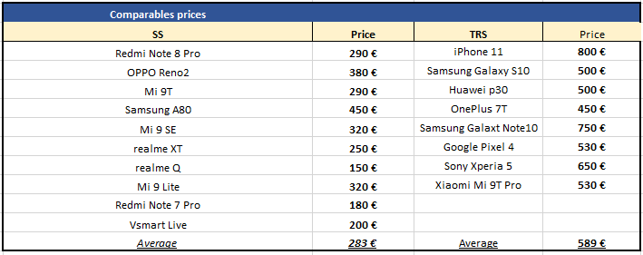
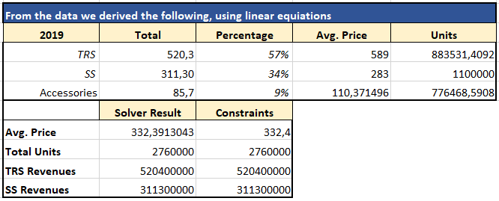
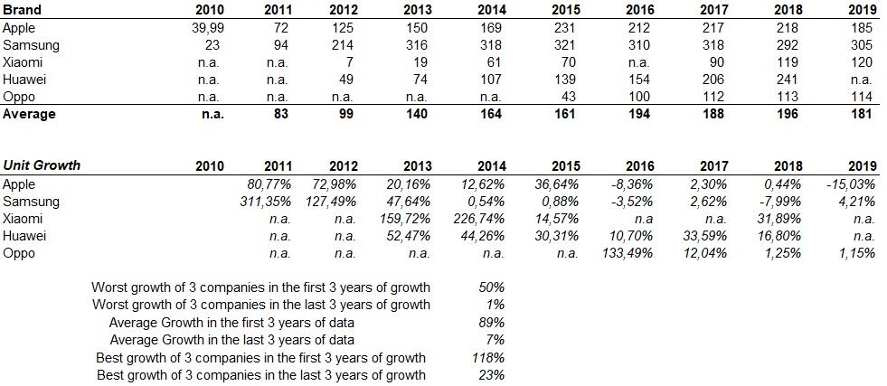
Discounted Cash Flow (DCF) Valuation of X-Phone
1
2
Factors to Consider
Company & Industry Overview
Notes:
\\TOCS2002\INVEST_DS\Multipub-creative\CREATIVE\Templates\Pitchbook Guidelines\TMT Templates - CIBC Excel.xls
Ownership Analysis (2)

Slide 9
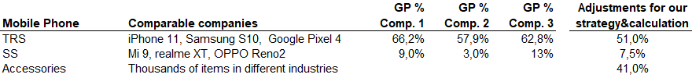
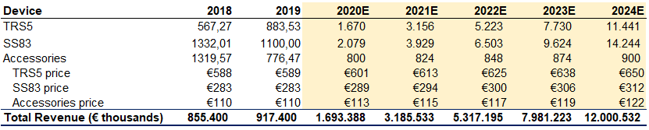
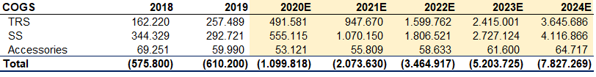
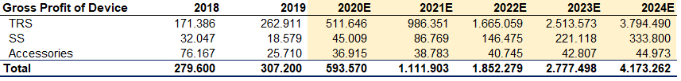
Discounted Cash Flow (DCF) Valuation of X-Phone
*2018 sales and units sold figures are derived from the information on the 4th page, calculating the figures from 2019 sales (2019 price is discounted to 2018, then the units sold are found)
1
2
Factors to Consider
Company & Industry Overview
Notes:
\\TOCS2002\INVEST_DS\Multipub-creative\CREATIVE\Templates\Pitchbook Guidelines\TMT Templates - CIBC Excel.xls
Ownership Analysis (2)

Slide 10
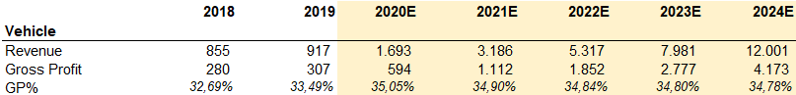
Discounted Cash Flow (DCF) Valuation of X-Phone
1
2
Factors to Consider
Company & Industry Overview
Notes:
\\TOCS2002\INVEST_DS\Multipub-creative\CREATIVE\Templates\Pitchbook Guidelines\TMT Templates - CIBC Excel.xls
Ownership Analysis (2)

Slide 11
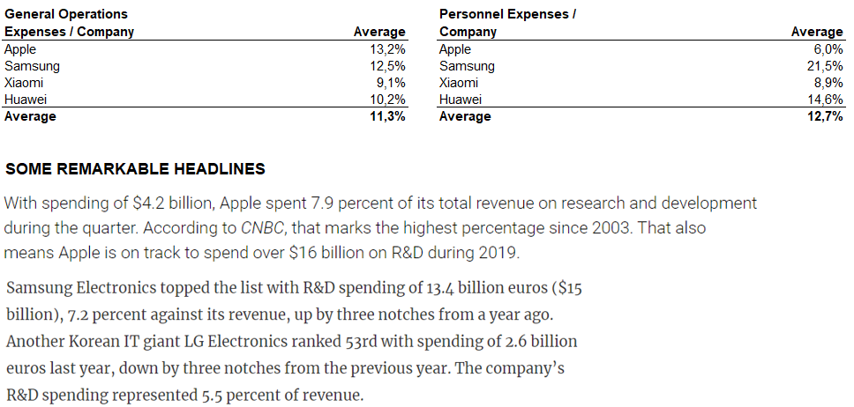
Discounted Cash Flow (DCF) Valuation of X-Phone
1
2
Factors to Consider
Company & Industry Overview
Notes:
\\TOCS2002\INVEST_DS\Multipub-creative\CREATIVE\Templates\Pitchbook Guidelines\TMT Templates - CIBC Excel.xls
Ownership Analysis (2)

Slide 12
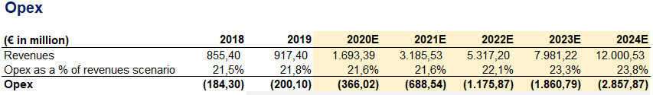
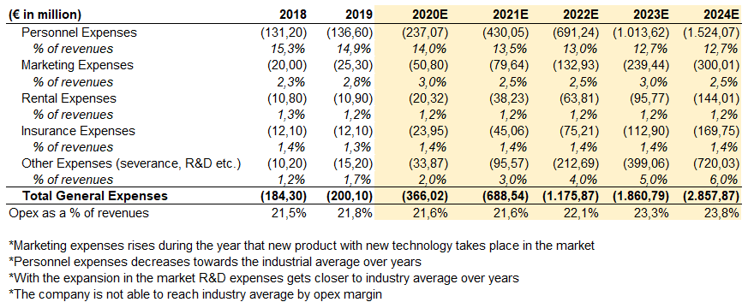
Discounted Cash Flow (DCF) Valuation of X-Phone
1
2
Factors to Consider
Company & Industry Overview
Notes:
\\TOCS2002\INVEST_DS\Multipub-creative\CREATIVE\Templates\Pitchbook Guidelines\TMT Templates - CIBC Excel.xls
Ownership Analysis (2)

Slide 13
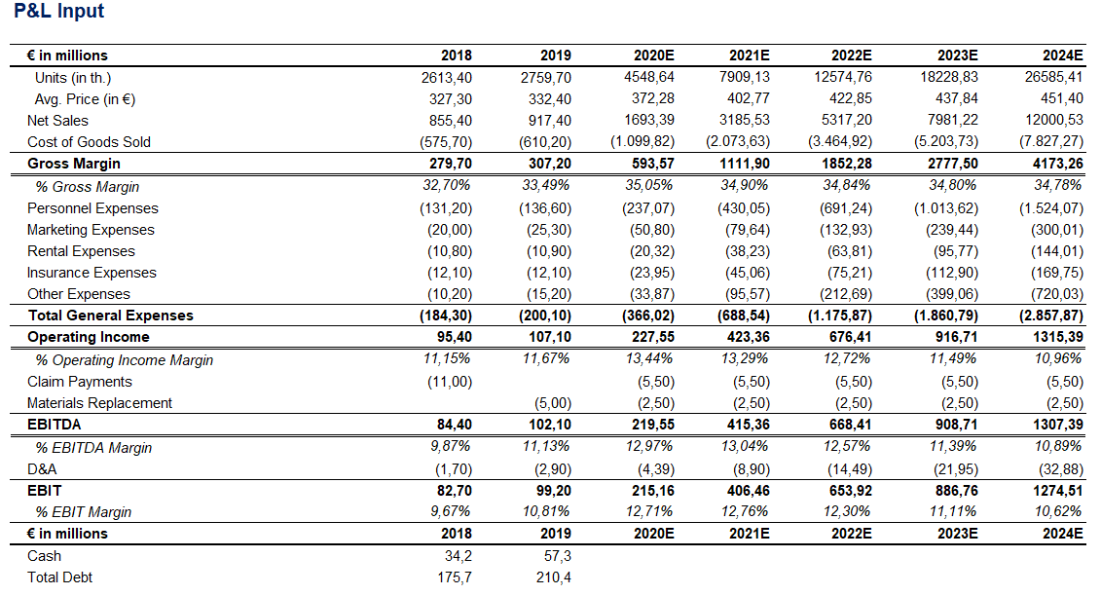
Discounted Cash Flow (DCF) Valuation of X-Phone
Operating Forecast
*Normalized EBITDA for 2019: 107,10 €m
1
2
Factors to Consider
Company & Industry Overview

Slide 14
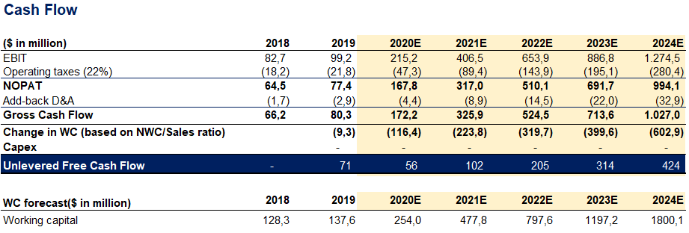
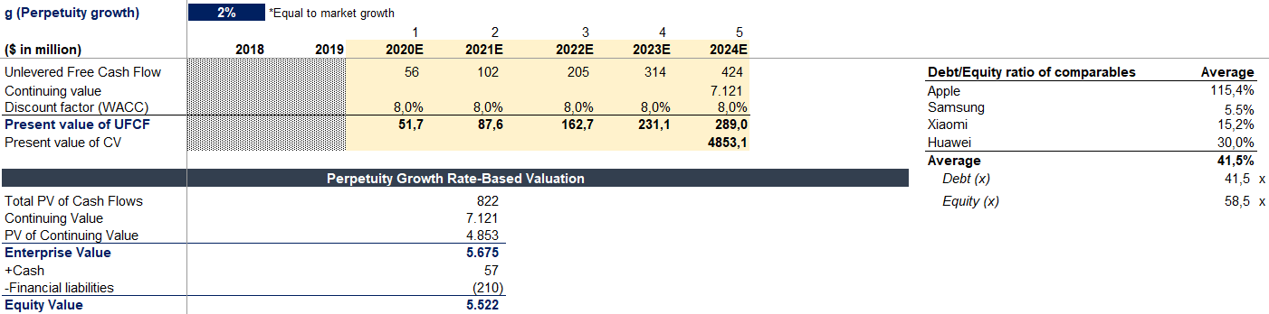
Discounted Cash Flow (DCF) Valuation of X-Phone
Operating Forecast
1
2
Factors to Consider
Company & Industry Overview

Slide 15
Multiples Valuation of X-Phone
Operating Forecast
 | Country | EV/EBITDA | Description
POTT | Germany | 9.4x | Development, manufacture and the sale of handyphone system (PHS), mobile phones, wireles telecommunication equipment, power line communication modems (PLC), protection switches and switched line modems.
Tech-ME | France | 3.3x | Micro speakers and receivers for mobile phones
Marketing & Sales | Japan | 12.2x | Integrated communication products, including mobile phones, smartphones, mobile computing services, digital entertaintment services, passive optical networking solutions, bluetooth accessories,cable modems and gateways
Technology & Development | China | 17.3x | Mobile phone handsets and related electronic communication products (mobile phones, communication systems and comouter components, modern office equipment), but does not assemble mobile phones
Black Amber | France | 10.9x | Mobile phones and accessories
InvenTer | Sweden | 5.2x | Wireless communication, entertainment multimedia and broadband products such as PDA, Wi-Fi Phones, SM/GPRS phones, smart phones MP3 players and GPS navigation devices
OhMyPhone | Belgium | 10.2x | Code division multiple Access (CDMA), mobile phones; data cards which are applicable to notebook computers and personal data assistant (PDA) portable device; wireless local loop (WLL) terminals such as desktop phone type and accessories such as batteries, data cables, travel charges, cigar charges and ear phones.
Average |  | 9,79x
1
2
Factors to Consider
Company & Industry Overview

Slide 16
Multiples Valuation of X-Phone
Operating Forecast
Market Cap (Equity found by DCF)
5.522 € m
Total Debt
210 € m
Cash
57 € m
EV (Market Cap + Total Debt +Cash)
5675 € m
1
2
Factors to Consider
Company & Industry Overview

Slide 17

Multiples Valuation of X-Phone
Operating Forecast
EBITDA
EV/EBITDA = 7.52x
RECOMMENDATION: BUY!
1
2
Factors to Consider
Company & Industry Overview

Slide 18
Thank you for listening

